Slide 1

CSE221: Algorithms
Breadth First Search
Prepared by: A B M Muntasir Rahman [MUNR]

Slide 2
Graph Traversal
Given a graph G = (V, E), and a source vertex s, we want to visit all the vertices Є V exactly once!
Two graph traversal algorithms: Breadth First Search (BFS) and Depth First Search (DFS)

Slide 3
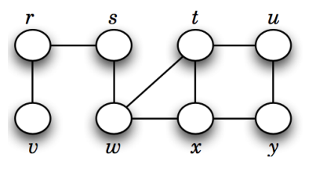
Breadth First Search (BFS)
Traverses the entire graph level-wise.
Uses Queue for traversal.
If we start from source vertex s,
then first level vertices are r, w
second level vertices are v, t, x
third level vertices are u, y
So, BFS traversal order will be,
s, r, w, v, t, x, u, y

Slide 4
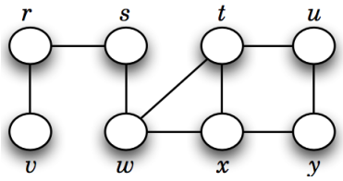
Simulation
Visited
0 | 0 | 0 | 0 | 0 | 0 | 0 | 0
r s t u v w x y
Distance
0 | 0 | 0 | 0 | 0 | 0 | 0 | 0
r s t u v w x y
Parent
N | N | N | N | N | N | N | N
r s t u v w x y

Slide 5
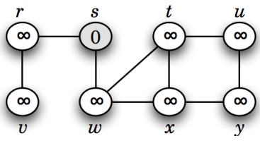

Simulation
Visited
0 | 1 | 0 | 0 | 0 | 0 | 0 | 0
r s t u v w x y
Distance
0 | 0 | 0 | 0 | 0 | 0 | 0 | 0
r s t u v w x y
Parent
N | -1 | N | N | N | N | N | N
r s t u v w x y

Slide 6
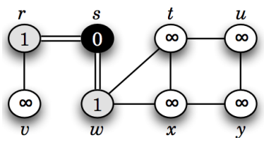

Simulation
Visited
1 | 1 | 0 | 0 | 0 | 1 | 0 | 0
r s t u v w x y
Distance
1 | 0 | 0 | 0 | 0 | 1 | 0 | 0
r s t u v w x y
Parent
s | -1 | N | N | N | s | N | N
r s t u v w x y

Slide 7
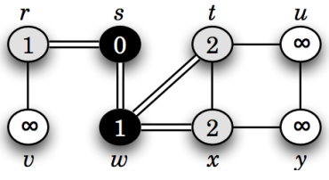

Simulation
Visited
1 | 1 | 1 | 0 | 0 | 1 | 1 | 0
r s t u v w x y
Distance
1 | 0 | 2 | 0 | 0 | 1 | 2 | 0
r s t u v w x y
Parent
s | -1 | w | N | N | s | w | N
r s t u v w x y

Slide 8
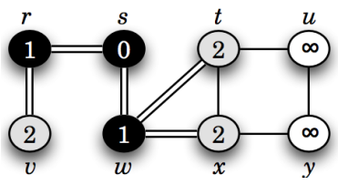

Simulation
Visited
1 | 1 | 1 | 0 | 1 | 1 | 1 | 0
r s t u v w x y
Distance
1 | 0 | 2 | 0 | 2 | 1 | 2 | 0
r s t u v w x y
Parent
s | -1 | w | N | r | s | w | N
r s t u v w x y

Slide 9
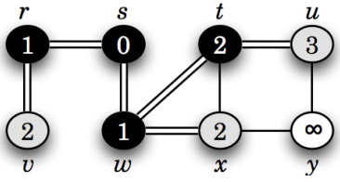

Simulation
Visited
1 | 1 | 1 | 1 | 1 | 1 | 1 | 0
r s t u v w x y
Distance
1 | 0 | 2 | 3 | 2 | 1 | 2 | 0
r s t u v w x y
Parent
s | -1 | w | t | r | s | w | N
r s t u v w x y

Slide 10
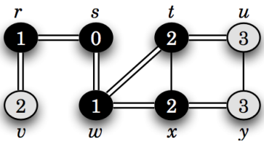

Simulation
Visited
1 | 1 | 1 | 1 | 1 | 1 | 1 | 1
r s t u v w x y
Distance
1 | 0 | 2 | 3 | 2 | 1 | 2 | 3
r s t u v w x y
Parent
s | -1 | w | t | r | s | w | x
r s t u v w x y

Slide 11
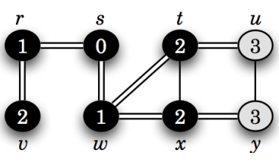

Simulation
Visited
1 | 1 | 1 | 1 | 1 | 1 | 1 | 1
r s t u v w x y
Distance
1 | 0 | 2 | 3 | 2 | 1 | 2 | 3
r s t u v w x y
Parent
s | -1 | w | t | r | s | w | x
r s t u v w x y

Slide 12
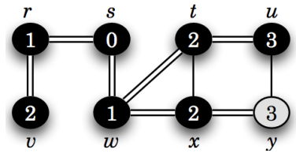

Simulation
Visited
1 | 1 | 1 | 1 | 1 | 1 | 1 | 1
r s t u v w x y
Distance
1 | 0 | 2 | 3 | 2 | 1 | 2 | 3
r s t u v w x y
Parent
s | -1 | w | t | r | s | w | x
r s t u v w x y

Slide 13
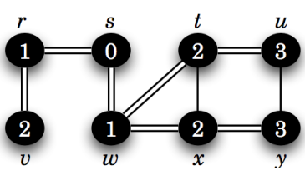

Simulation
Visited
1 | 1 | 1 | 1 | 1 | 1 | 1 | 1
r s t u v w x y
Distance
1 | 0 | 2 | 3 | 2 | 1 | 2 | 3
r s t u v w x y
Parent
s | -1 | w | t | r | s | w | x
r s t u v w x y

Slide 14
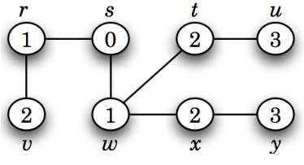
Simulation
BFS traversal sequence will be,
s, r, w, v, t, x, u, y

Slide 15
Simulation
Visited
What is the shortest distance between s to u?
Ans: Go to index u of distance array (3)
What is the shortest path from s to u?
Ans: Go to index u of parent array (t). Since t is not source, go to index t (w). w is not the source, so go to index w (s). Since s is source,
path will be s -> w -> t -> u.
1 | 1 | 1 | 1 | 1 | 1 | 1 | 1
r s t u v w x y
Distance
1 | 0 | 2 | 3 | 2 | 1 | 2 | 3
r s t u v w x y
Parent
s | -1 | w | t | r | s | w | x
r s t u v w x y

Slide 16
BFS Pseudocode
BFS(G, s)
Q = [], visited = [], parent = [], distance = []
visited[s] = 1, parent[s] = -1, distance[s] = 0
ENQUEUE(Q, s)
while Q is not empty
u = DEQUEUE(Q) //Dequeued sequence is the BFS sequence
for each vertex v Є Adj[u]
if visited[v] = 0
visited[v] = 1
distance[v] = distance[u] + 1
parent[v] = u
ENQUEUE(Q, v)

Slide 17
BFS Properties
Can find the shortest path and minimum distance required to traverse from a source vertex to all other vertices in an unweighted graph.
Can always find the solution.
In case of directed graph, not all vertices may be explored.
Not suitable for detecting cycles in a graph.
Time Complexity: O(n + m)
Space Complexity: O(n + m)

Slide 18
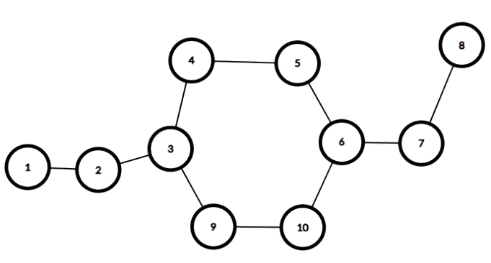
Bipartite/Bicolorable Graph
A graph that can be colored using exactly two colors
However, no two adjacent vertices should have the same color
G
G
B
Let’s assume two colors, B -> Blue
G -> Green
B
G
B
G
B
even cycle
G
B

Slide 19
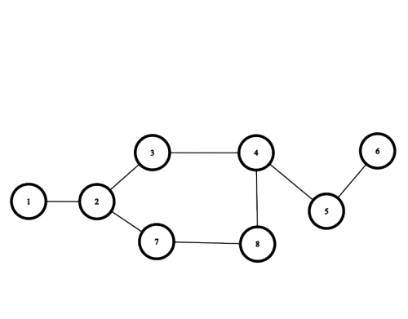
Bipartite/Bicolorable Graph
B
G
G
B
G
odd cycle
B
B
G
This is not bipartite graph!

Slide 20
Bipartite Graph Detection
Therefore, it can be said that, any graph that has
Odd Cycle -> is not a bipartite graph
Even Cycle -> is a bipartite graph
Similarly,
Bipartite Graph -> means it has even cycle
Non Bipartite Graph -> means it has odd cycle

Slide 21
Bipartite Graph Detection using BFS
Bipartite(G, s)
Q = [], visited = [], color = []
visited[s] = 1, color[s] = "B"
ENQUEUE(Q, s)
while Q is not empty
u = DEQUEUE(Q)
for each vertex v Є Adj[u]
if visited[v] = 0 then visited[v] = 1
if color[u] == "B" then color[v] = "G"
else color[v] = "B"
ENQUEUE(Q, v)
else if color[u] == color[v] return False
return True

